Slide 1
Automatic Subtitle Encoder using Machine Translation
Team Members
Mukeshwar S (715517104041)
PremKumar A (715517104044)
Project Guide
Dr.S.Bhuvana

Slide 2
Automatic Subtitle Encoder
Traditionally, people use to download and load subtitles for any other language videos/movies from the internet.
Downloading subtitles from the internet is a monotonous process and at times, people find difficult to search for subtitles in every language.
Generating subtitles automatically is a valid subject of research.
To propose a model for generating automatic subtitle for the users in their own preferred language so that they can reduce their time and effort.

Slide 3
Proposed methodology
The project resolves into three distinct modules:
- Audio Extraction which converts an input file of any format supported by MPEG standards to audio format
- Then Speech Recognition of the extracted audio file is implemented
- Finally, Subtitle Generation in which a.txt/.srt file is generated which is synchronized with the input video file.

Slide 4
Automatic Subtitle Encoder
Input Video
Converting to Audio file
Preprocessing
(remove noise and make chunk audio files by silence)
Machine Translation
Making Time Frame
Audio files to Text
Making Synchronized Text with the video file

Slide 5
Encoder Mechanism
For subtitle generation first, the input file goes through Audio Extraction where the input file must be of the formats supported by FFMPEG standards such as .mp3, .mp4, .avi, .au, and .flac .
The Implementation involves following three Phases.
A)Audio Extraction
B)Speech Recognition
C)Subtitle Generation

Slide 6
Audio Extraction
The input video file passes through demuxer where audio is separated from video and then, audio stream is divided into frames of binary format.
In order to remove noise from audio stream,compression algorithm is used with the help of Psychoacoustic Model.
This model provides lossy compression of the signal.
This resulting binary data is converted to sinusoidal signal to pass as input to muxer where the separated audio signals are combined together under file extension format.

Slide 7
Speech Recognition
Now, the extracted audio file is used to generate a .srt file using Speech Recognition in which the audio undergoes three modules, the Front End, Decoder and the Knowledge Base.
Words that have more probability of occurrence get a high score and the one with lower probability are pruned using the pruner.
This process is repeated until all the words are recognized and an .srt file is generated.

Slide 8
Subtitle Generation
The srt file comprises of sentences along with their corresponding time line in the video.
Machine Translation is done using google translate depends on the user requirements.
This file is then further embedded in the video where the lyrics are synchronized with the time and displayed with the video.

Slide 9
Implementation
PROGRAM:
#Importing necessary library
import six
import subprocess
import ffmpeg
from google.oauth2 import service_account
from google.cloud import translate_v2 as translate
import xlwt
from xlwt import Workbook
import time
import pysrt
import xlrd
import os
from google.cloud import storage
import shlex
import ntpath
#Establishing connection with Google cloud service
obj=“XXXXXXXXXXXXXXXXXXXXXXX"
buck_name=“YYYYYYYYYYYYYYY"
credentials = service_account.Credentials.from_service_account_file(obj)
storage_client=storage.Client.from_service_account_json(obj)

Slide 10
PROGRAM Cont...
def subtitle_gen(gcs_uri,language,to_language,video_filename,output_filename):
#Speech recognition
from google.cloud import speech
client = speech.SpeechClient(credentials=credentials)
audio = speech.RecognitionAudio(uri=gcs_uri)
config = speech.RecognitionConfig(
encoding=speech.RecognitionConfig.AudioEncoding.FLAC,
language_code=language,
audio_channel_count=2,
enable_word_time_offsets=True)
operation = client.long_running_recognize(config=config,audio=audio)
print('Waiting for operation to complete...')
result = operation.result()
#From a huge data collecting necessary data and storing in list
json = []
for section in result.results:
data = {"transcript": section.alternatives[0].transcript,"words": []}
for word in section.alternatives[0].words:
data["words"].append({"word": word.word,
"start_time": word.start_time.total_seconds(),
"end_time": word.end_time.total_seconds(),
"speaker_tag": word.speaker_tag
})
json.append(data)

Slide 11
PROGRAM Cont..
#From the list of words ,forming a sentence based on silence or different speaker tag
sentences = []
sentence = {}
for result in json:
for i, word in enumerate(result['words']):
wordText = word['word']
print(wordText)
if not sentence:
sentence = {language: [wordText],'speaker': word['speaker_tag'],'start_time': word['start_time'],'end_time': word['end_time']}
# If we have a new speaker, save the sentence and create a new one
elif word['speaker_tag'] != sentence['speaker']:
sentence[language] = ' '.join(sentence[language])
sentences.append(sentence)
sentence = {language: [wordText],'speaker': word['speaker_tag'],'start_time': word['start_time'],'end_time': word['end_time']}
else:
sentence[language].append(wordText)
sentence['end_time'] = word['end_time']
# If there's greater than one second gap, assume this is a new sentence
if((i+6< len(result['words'])) and ((word['end_time'] < result['words'][i+1]['start_time']) or (sentence['start_time']+10 < sentence['end_time']))):
sentence[language] = ' '.join(sentence[language])
sentences.append(sentence)
sentence = {}
if sentence:
sentence[language] = ' '.join(sentence[language]) sentences.append(sentence) sentence = {}

Slide 12
PROGRAM Cont..
#Converting sentence into the target language and storing in Excel sheet with the timestamp
wb = Workbook()
row,column,index=0,0,0
sheet1 = wb.add_sheet('DATA')
for var in sentences:
input1=var[language]
start_time=var['start_time']
end_time=var['end_time']
translate_client = translate.Client(credentials=credentials)
if isinstance(input1,six.binary_type):
input1=input1.decode("utf-8")
result = translate_client.translate(input1, target_language=to_language)
sheet1.write(row, column, index)
index+=1
column+=1
sheet1.write(row, column, time.strftime('%H:%M:%S',time.gmtime(start_time)))
column+=1
sheet1.write(row, column, time.strftime('%H:%M:%S',time.gmtime(end_time)))
column+=1
sheet1.write(row, column, result['translatedText'])
row+=1
column=0
wb.save('DATA.xls')

Slide 13
PROGRAM Cont..
#Creating a custom srt file and merging with the video file
wb=xlrd.open_workbook("DATA.xls")
sheet=wb.sheet_by_index(0)
row,column=0,0
total=sheet.nrows
with open("subtitle.srt","w",encoding='UTF-8') as f:
while(total):
total-=1
f.write(str(int(sheet.cell_value(row,column))+1))
column+=1
f.write("\n")
f.write(str(sheet.cell_value(row,column))+",000")
column+=1
f.write(" --> ")
f.write(str(sheet.cell_value(row,column))+",000")
column+=1
f.write("\n")
f.write(sheet.cell_value(row,column))
f.write("\n")
f.write("\n")
row+=1
column=0
command="ffmpeg -i "+video_filename+" -i subtitle.srt -c:s mov_text -c:v copy -c:a copy "+output_filename
args=shlex.split(command)
subprocess.Popen(args)

Slide 14
PROGRAM Cont..
#Main function
def call_main(video_filename):
length=len(video_filename)
command="ffmpeg -i "+video_filename.replace(" ","")+" "+video_filename[:length-4].replace(" ","")+".flac"
args=shlex.split(command)
subprocess.call(args)
global output_filename
output_filename=video_filename[:length-4].replace(" ","")+"(with-"+input2+"-subtitle).mp4"
global audio_filename
audio_filename=video_filename[:length-4].replace(" ","")+".flac"
bucket=storage_client.get_bucket(buck_name)
blob=bucket.blob(audio_filename)
blob.upload_from_filename(audio_filename)
#To select a Video from PC
def pc_click():
filename=filedialog.askopenfilename()
path_text_obj.insert(0,filename)
global video_filename
video_filename=ntpath.basename(filename)
print(video_filename)
call_main(video_filename)

Slide 15
PROGRAM Cont..
#To download from Youtube
def u_click():
try:
from pytube import YouTube
from pytube import Playlist
except Exception as e:
print("Error")
url=path_text_obj.get()
ytd=YouTube(url)
ytd=YouTube(url).streams.first().download()
os.rename(ytd,ytd.replace(" ",""))
video_filename=ntpath.basename(ytd)
print(video_filename)
call_main(video_filename)
#Translator function
def translator():
subtitle_gen("gs://"+buck_name+"/"+audio_filename,source_lang,target_lang,video_filename.replace(" ",""),output_filename)

Slide 16
PROGRAM Cont..
#Initializing Tkinter Window
root = Tk()
root.title("Automatic Subtitle Encoder")
#encoder_icon = PhotoImage(file = "languages.png")
#root.iconphoto(True, encoder_icon)
root.resizable(0,0)
bg_image = ImageTk.PhotoImage(Image.open("maxresdefaultfinal.jpg"))
#Creating Canvas Object
canvas = Canvas(root, width=bg_image.width(), height=bg_image.height())
canvas.create_image(0,0,anchor='nw',image=bg_image)
canvas.pack()
#Configuring Style for GUI Components
fontstyle = ("Arial Rounded MT Bold",10,"bold")
style = ttk.Style()
style.theme_create('combostyle', parent='alt', settings={'TCombobox‘:{'configure‘:{'fieldbackground': '#d3e0ea‘, 'background': '#276678‘,'highlightbackground' : '#276678‘, }}})
style.theme_use('combostyle‘)
#Text Label for required Fields
canvas.create_text(400,100, text="AUTOMATIC SUBTITLE", font=("Typo Draft Demo", 35),fill="#9fd8df")
canvas.create_text(410,150, text="ENCODER", font=("Typo Draft Demo", 35),fill = "#9fd8df")
canvas.create_text(160,300, text="Path for SRT File : ", font=("Arial Rounded MT Bold", 18),fill = "#a4ebf3")
canvas.create_text(160,550, text="Needed Language : ", font=("Arial Rounded MT Bold", 18),fill = "#a4ebf3")
canvas.create_text(160,450, text="Source Language : ", font=("Arial Rounded MT Bold", 18),fill = "#a4ebf3")

Slide 17
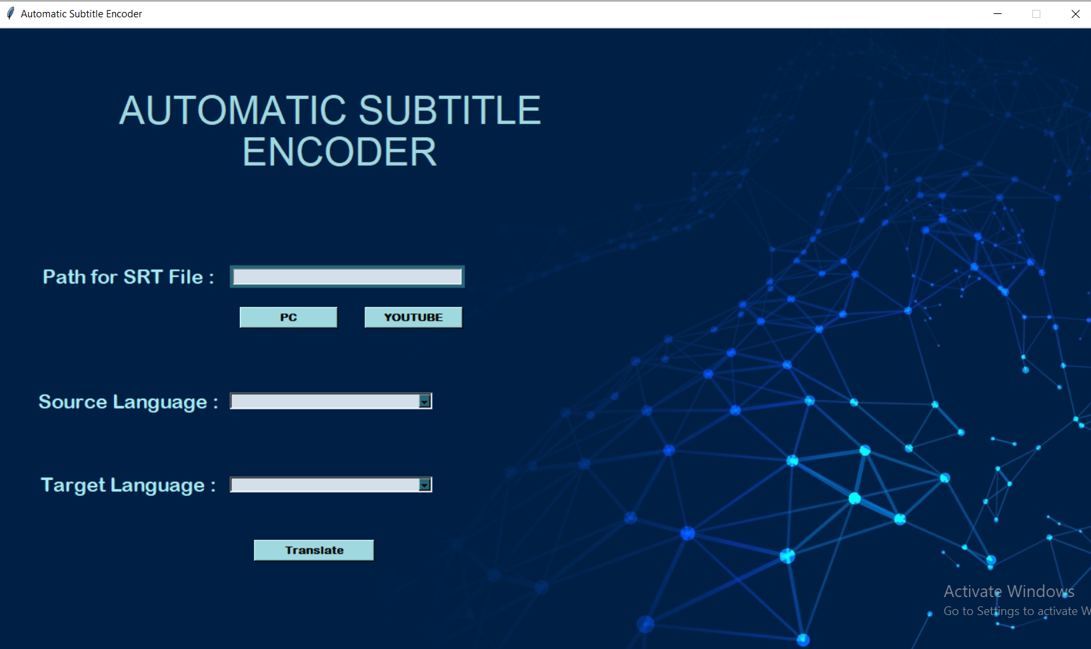
Screenshot

Slide 18
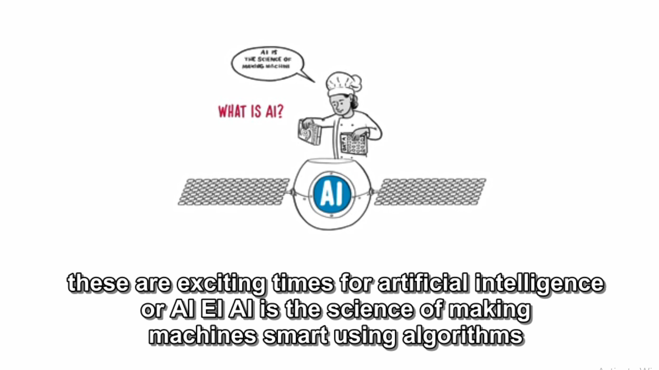
OUTPUT

Slide 19
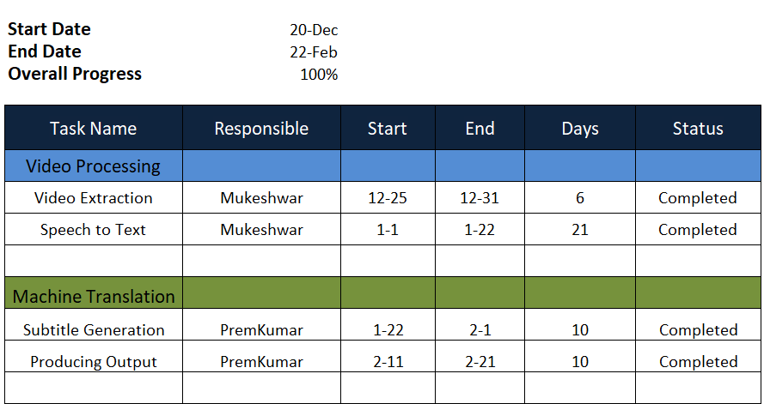
Timeline of the Project

Slide 20
References
Chen, R. Wang, M. Utiyama, Sumita E and Zhao T, "Neural Machine Translation with Sentence-Level Topic Context," IEEE Transactions on Audio, Speech, and Language Processing, Vol. 27, No. 12, December 2019
Lero R D, Exton C and A. Le Gear, "Communications using a speech-to-text-to-speech pipeline," International Conference on Wireless and Mobile Computing, Networking and Communications, December 2019.
Mathur A, Saxena T and Krishnamurthi S, "Generating Subtitles Automatically Using Audio Extraction and Speech Recognition," IEEE International Conference on Computational Intelligence & Communication Technology, 2015.
Ramani A, Rao, Vidya V and Prasad V B, "Automatic Subtitle Generation for Videos," 6th International Conference on Advanced Computing and Communication Systems (ICACCS), March 2020
Satpathy, Mishra and Nayak A K, "Analysis of Learning Approaches for Machine Translation Systems," International Conference on Applied Machine Learning (ICAML), 2019.

Slide 21
Any Queries!

